Slide 1

Database Systems
Lecture 1: Course Overview
Prof. Aziz Nasridinov (aziz@chungbuk.ac.kr)

Slide 2
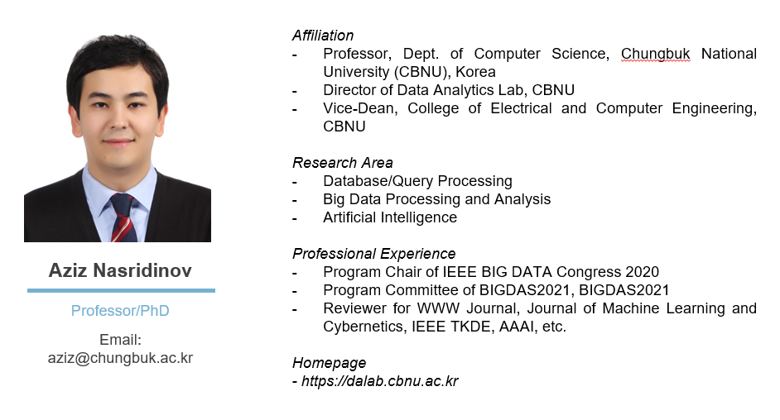
Course Instructor

Slide 3
Course Objectives
Database Fundamentals
Objective 1
Key concepts and theories related to the database systems
Database Management
Objective 2
How to create, insert, update and delete data using open source DBMS (MySQL)
Database Design
Objective 3
How to design database using E-R Diagram and map it into relational schema
Objective 4
Database Tuning
Database indexing, view, catalog, normalization
Database Practice
Objective 5
Develop DB-driven applications using various programming languages (PHP and Python)

Slide 4
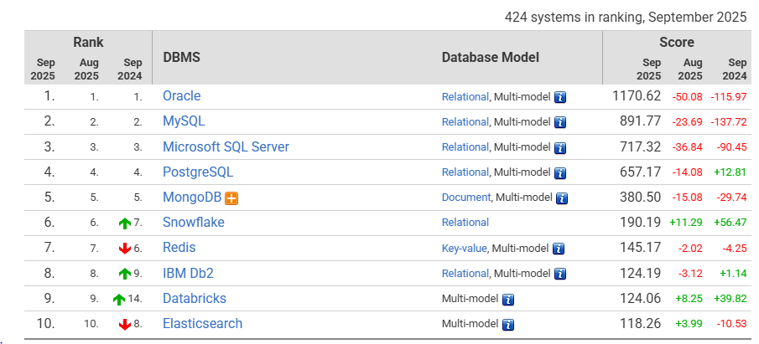
Course Features
Source: https://db-engines.com/en/ranking

Slide 5
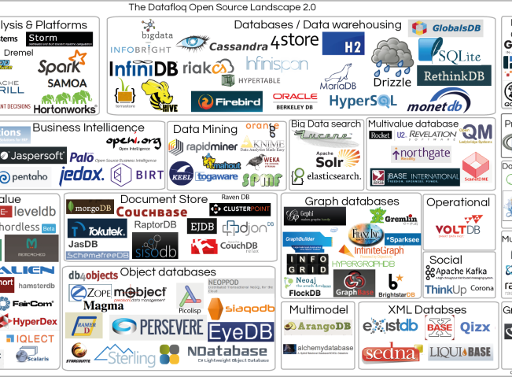
Course Benefits
English Lectures
Practice
Lecture materials, exams and grading are all in English
Practice developing database applications using real-life examples
Special Lectures
Certificate Support
Lectures from industry experts
(Kookmin Bank,
Samsung)
Organize lectures for SQL Developer, SQL Professional

Slide 6
Certificate Support
SQL Developer Certification
National certification supported by all major companies.
Price: 50,000 Korean Won
SQL Professional Certification
Professional level certification for SQL.
Price: 50,000 Korean Won
https://www.dataq.or.kr/www/main.do

Slide 7
Course Schedule
  Note that the schedule is subject to changes
Intro to DB
Database Design
Recent Techs
Data, database, relational model and constraints, keys
Entity-relation diagram (E-R Diagram) and schema mapping
Big data, data mining, NoSQL database, skyline
Sep
Nov
Start
SQL
Oct
Database Tuning
Dec
CRUD operations using beginner, intermediate and advanced SQL
Database indexing, view, catalog, normalizations, security

Slide 8

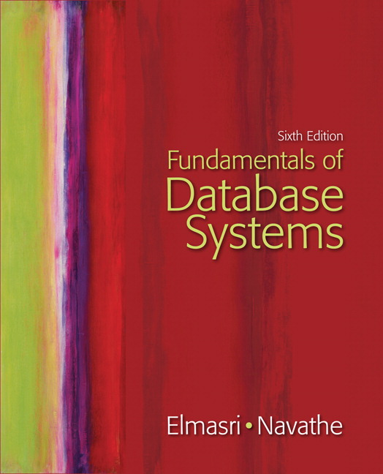
Textbook and
References
MS-SQL Server Based Database Learner
01
홍의경, 생능출판사,
2015
Fundamentals of Database Systems
02
R. Elmasri, B. Navathe
Pearson, 2016
Database System Concepts
03
Avi Silberschatz
McGraw-Hill, 2017

Slide 9
Course Evaluation
30%
30%
30%
10%
Mid-Term Examination
Final
Examination
Homework
Attendance and Attitude
Six tasks 5 points each that will be used to check your progress
Mid semester and related to relational database and E-R Diagram
Related to database optimization techniques

Slide 10
Course Policies
Lecture Style
Lecture 50% and practice 50%
Lecture Notes
Attendance
Lecture notes will be available via CBNU Blackboard 10 minutes before the lecture
Missing the class without any reason will result in point reduction (-2), for being late (-1)
AI
You are NOT allowed to use ChatGPT or any other AI generators during the practices

Slide 11
Questions?
See you next time!

